Slide 1
Mansoura Intake42
Project Requirement
Example Scenario
Adding a new Square
(Page 6 in project document)

Slide 2
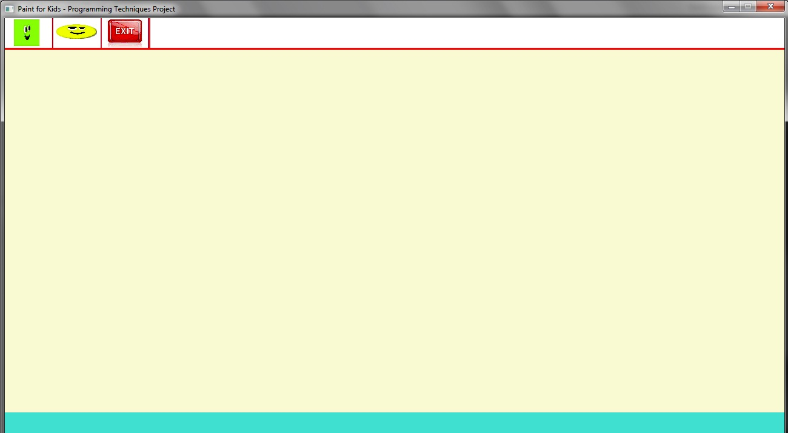
Drawing a new Square
User Perspective
Application is waiting for user action
User clicks on ”Square” icon
Messages appear on status bar and user selects two point (corners)
A Square is drawn
New Square: Click at second point
New Square: Click at first point

Slide 3
Steps to execute ANY operation
Application Perspective
4 basic steps to execute any operation:
Step I: Map User Input to Action Type
Step II: Create Corresponding Action Object
Step III: Execute the Created Action
Now Action is complete but not reflected yet to GUI
Step IV: Update Interface

Slide 4
Drawing a Square
Steps Details
Step I: Get User Input & Map to Action Type
  User clicks on “Square” icon in the toolbar
  GUI class maps it to DRAW_SQUARE action type (enum)
Step II: Create Corresponding Action Object
  Create Object of class ActionAddSquare
Step III: Execute the Created action
  Ask user to click on two points
  Create Object of class CSquare
  Add the CSquare object to the list of Figures ➔ Square. is saved
Step IV: Update Interface
  For each Figure in the list, call DrawMe function
  Each Figure calls the appropriate draw function from GUI class. CSquare ::DrawMe calls GUI::DrawSquare ➔ Square. is shown

Slide 5
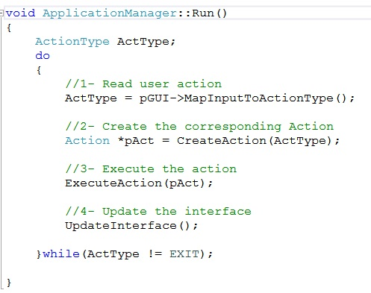
Step I: Map input to Action Type

Slide 6
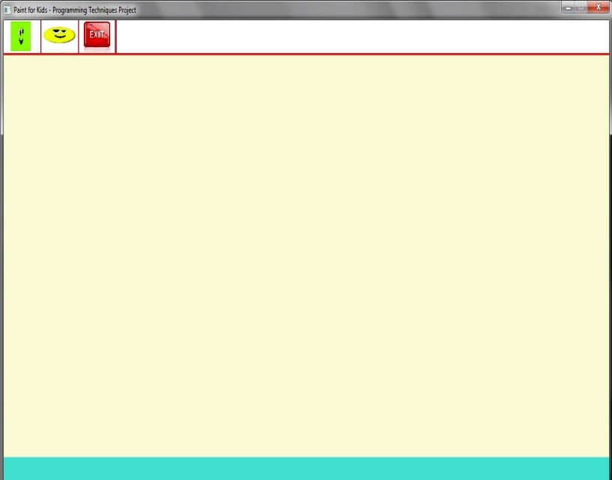
Step I: Map input to Action Type
enum ActionType
{
DRAW_SQUARE,
DRAW_ELPS,
DRAW_HEX,
CHNG_DRAW_CLR,
……………………………
Application Manager
Function Run( )
4
Returns:
DRAW_SQUARE
(enum)
1
pGUI->MapGUIputToAc….()
Click Square icon
2
WaitMouseClick()
GUI
Area Checking &
Action Recognition
3
(x, y)
Click Position

Slide 7
Step II: Create corresponding action

Slide 8
Step II: Create corresponding action
1
AppManager.CreateAction(ActionType ActType);
AllpicationManager
switch(ActType)
{
case DRAW_SQUARE
pAct (pointer)
Action* pAct = NULL; //polymorphism
2
NULL
ActionAddSquare (derived class)
Execute( )
//switch-case ➔ create the action
pAct = new ActionAddSquare (this);
3

Slide 9
Step III: Execute the action

Slide 10
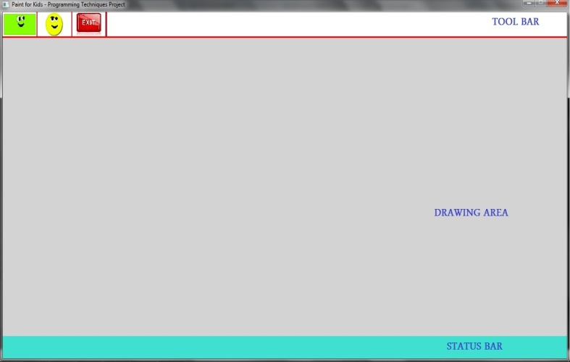
Step III: Execute the action (1/2)
Collect Action Parameters
pGUI->PrintMessage(message);
//is Called twice
ActionAddSquare
Function Execute( )
1
GUI
2
Print 2 messages on status bar
to ask user to click at 2 points
3
pGUI->GetPointClicked();
6
(x1, y1)
(x2, y2)
4
WaitMouseClick(x, y)
GUI
User clicks at two points
say(x1, y1) and (x2,y2)
(x1, y1) , (x2, y2)
The 2 points
5

Slide 11
Step III: Execute the action (2/2)
Create the Square Object and add it
2
pManager-> AddFigure(pS)
//ask the App. manager to add the Aquare
to the list of Figures “FigList”
//polymorphism: CFigure * FigList[MaxFigCount];
Application Manager
CFigure* FigList[ ]
ActionAddSquare
Function Execute( )
//calc. square topleft corner and length
//SqrGfxInfo stores draw color, fill color, etc
//Create CSquare Object
pS = new CSquare(topLeft, Len, SqrGfxInfo)
CFigure *
CFigure *
CFigure *
CFigure *
CFigure *
CFigure *
CFigure *
1
CSquare
(derived class)

Slide 12
Step IV: Reflect the action to the Interface

Slide 13
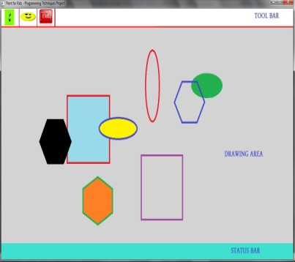
Step IV: Reflect the action to the Interface
ApplicationManager
Function Run( )
1
UpdateInterface( );
Application Manager
FigList [ ]
Loop on each figure in the list
FigList[i]->DrawMe(pGUI);
//CFigure::DrawMe()
//is a pure virtual fn.
2
CFigure *
CFigure*
CFigure*
CFigure*
CFigure*
CFigure*
CFigure*
CSquare
Function DrawMe( )
3
pGUI->DrawSquare(…);
GUI
Function DrawSquare( )
5
All figures
are drawn
4

Slide 14
Thank You ☺

